Slide 1
IPL Prediction System Using Random Forest Ensimble Learning And Logistic Regression
G. Tanay Tej – 2420030560
Nandan Varma –
M. Arjun–
Guide - DR.N.SUNANDA

Slide 2
Problem Statement
IPL matches are influenced by several factors such as team performance, player statistics, venue, toss result, batting and bowling performance, and previous match records. Predicting the outcome of an IPL match manually can be difficult because of the large amount of historical data involved.
The main problem is to develop a machine learning-based system that can analyze historical IPL match data and predict the likely winner of a match.
The proposed IPL Prediction System uses Random Forest Ensemble Learning and Logistic Regression to identify patterns in historical data and generate predictions about the winning team.

Slide 3
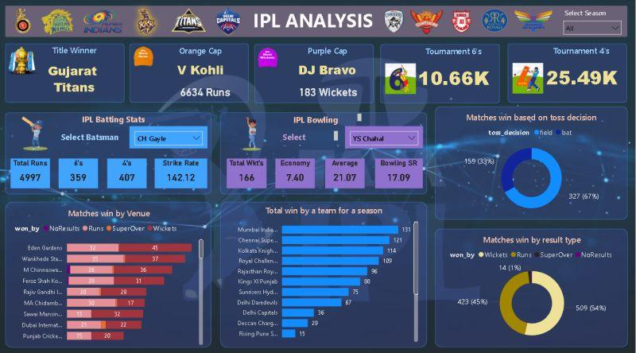
Real-world relevance
IPL generates a large amount of statistical data related to teams, players, matches, venues, and performances.
The proposed system can be useful for:
Analyzing team performance.
Understanding factors affecting match outcomes.
Comparing different teams based on historical performance.
Supporting cricket analysts in making data-driven predictions.
Demonstrating the practical application of machine learning in sports analytics.
The project shows how historical sports data can be transformed into meaningful predictions using machine learning techniques.

Slide 4
Motivation for selecting the problem
Cricket is highly data-driven, and IPL provides a large collection of historical match and player statistics.
The main motivation for selecting this problem is to understand how machine learning algorithms can be applied to sports prediction.
The project provides an opportunity to work with real-world datasets, perform data preprocessing, select important features, train machine learning models, and evaluate prediction performance.
Using both Random Forest and Logistic Regression allows us to compare different machine learning approaches for predicting IPL match outcomes.

Slide 5
Objectives
specific and measurable objectives:
To collect and preprocess historical IPL match data.
To identify important factors that influence match outcomes.
To perform exploratory data analysis on IPL datasets.
To prepare relevant features for machine learning.
To develop a prediction model using Random Forest Ensemble Learning.
To develop a prediction model using Logistic Regression.
To compare the performance of both models.
To evaluate the models using suitable performance metrics.
To predict the likely winning team based on match-related information.

Slide 6
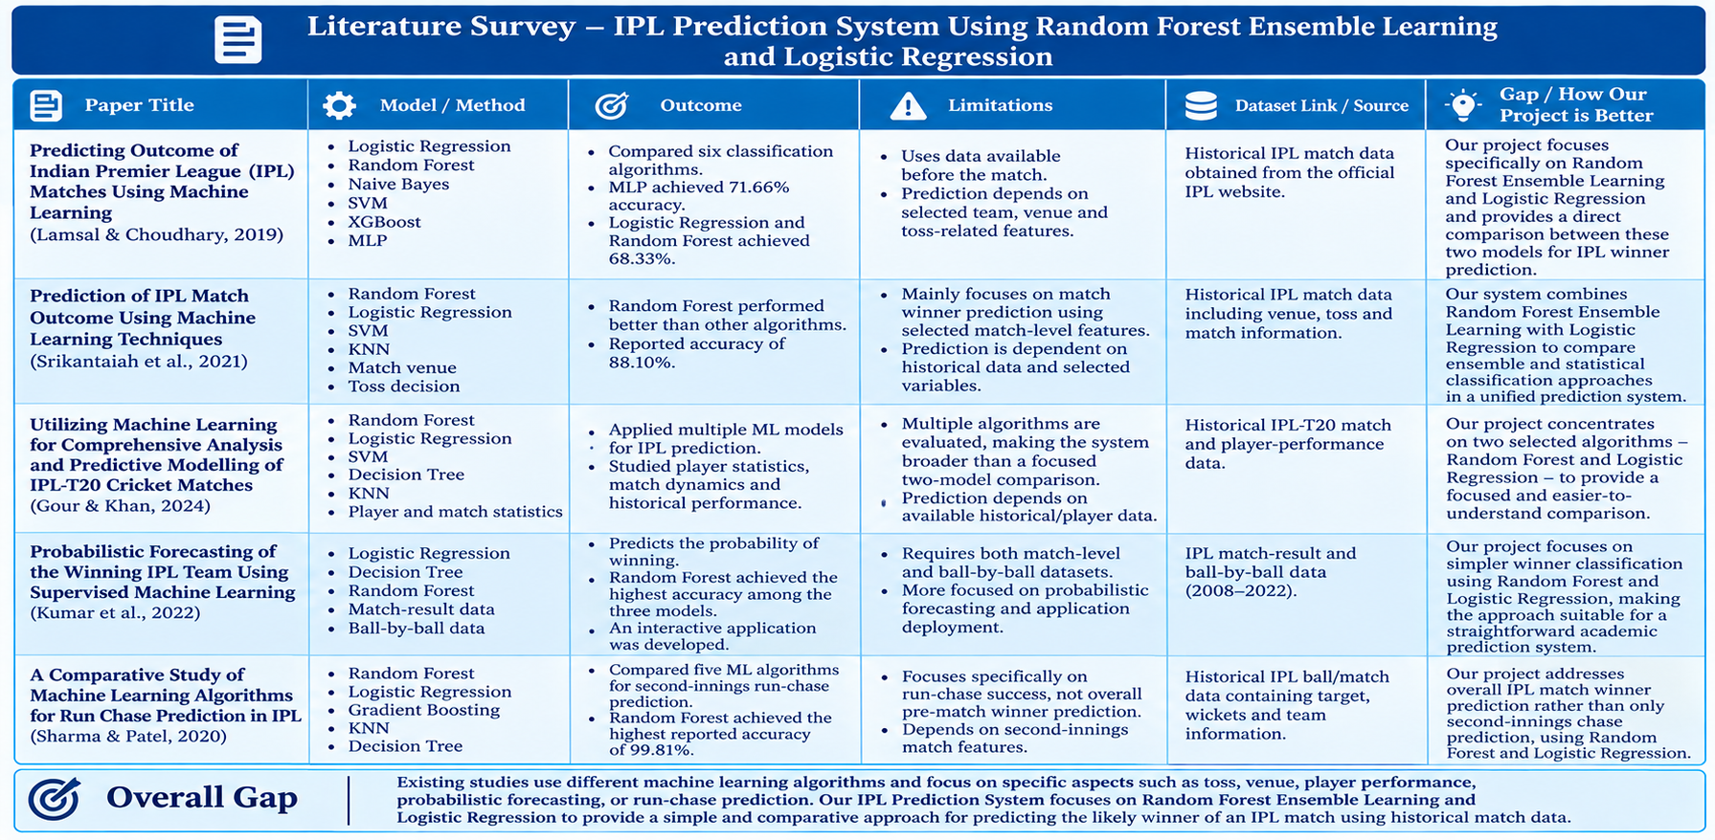
Literature survey/existing system

Slide 7
Project Methodology
Data Collection → Collect IPL historical data
Data Preprocessing → Clean and prepare data
Feature Selection → Select important features
Model Training → Random Forest + Logistic Regression
Model Evaluation → Compare model performance
Prediction → Predict the match winner

Slide 8
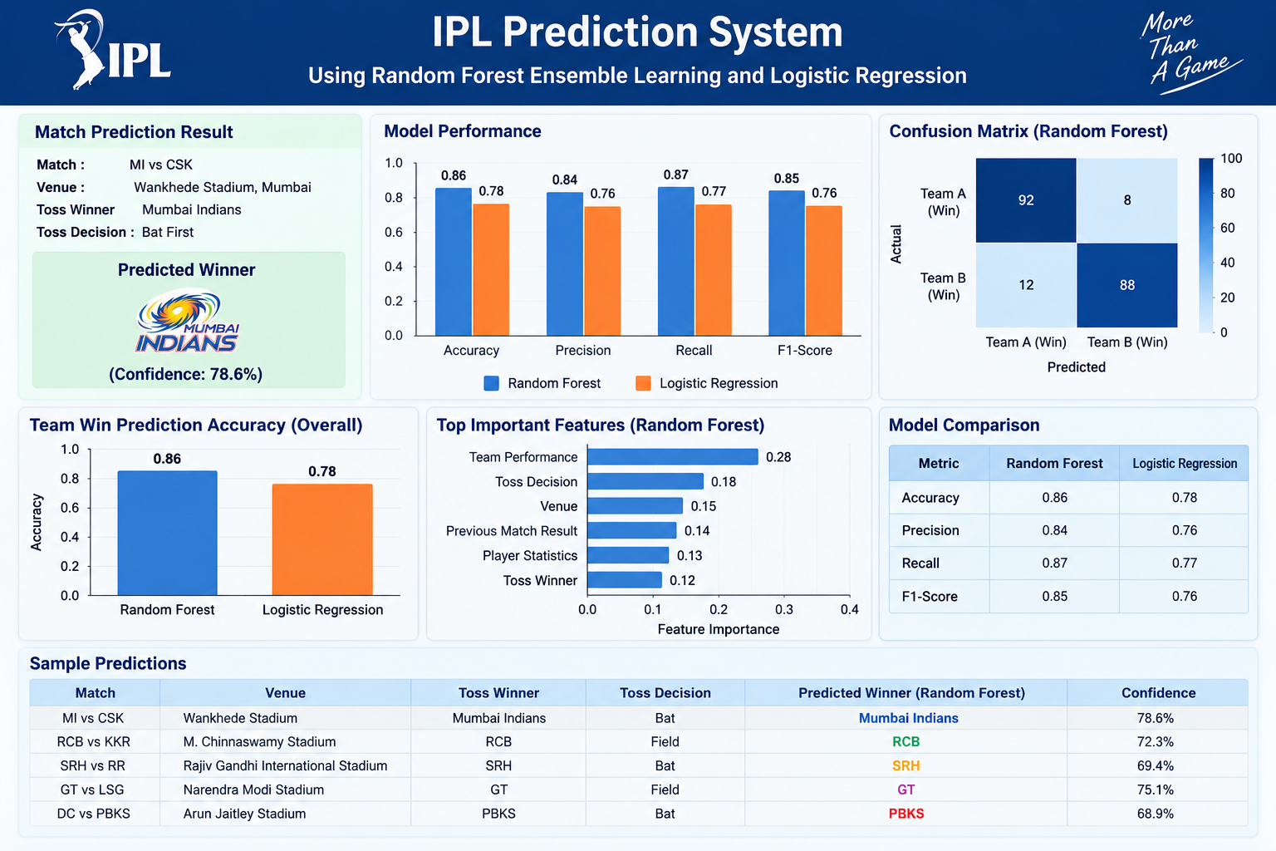
EXPECTED OUTCOME

Slide 9
THANK YOU

